Slide 1
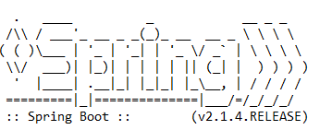

How to disable spring logo banner in spring boot?
By default, all spring boot applications will show up below spring logo banner in all spring boot applications.
We can disable spring logo in various ways using banner-mode, banner-mode comes with there options:
CONSOLE: Print the banner to System.out.
LOG: Print the banner to the log file.
OFF: Disable printing of the banner

